Slide 1
Blending Up Social Solutions
Christian Finn
Director
Microsoft Corporation

Slide 2
A Presentation in Five Acts
In Homage to This American Life
Act I: The Issues
Act II: A Blended Solution
Act III: Mythbusting
Act IV: Have Your Cake, & Eat It, Too
Act V: All About You

Slide 3
Act I: The Issues

Slide 4





The Rise of Web 2.0
Source: Technorati
Notes:
This chart shows the tremendous exponential growth of blogs created since 2003.
There are now 50MM blogs on the Web – the same type of exponential growth can be seen for Facebook, LinkedIn, YouTube, and Wikipedia
These technologies are gaining considerable traction on the Web as people are finding these tools more valuable.
When do you think your organization will get to this height of adoption of social computing tools?
What are the factors that drive this exponential growth?
How is social computing for users’ personal life different from social computing for users’ professional life?
-----
Background about Web 2.0:
Web 2.0, a phrase coined by O'Reilly Media in 2003^{[1]} and popularized by the first Web 2.0 conference in 2004,^{[2]} refers to a perceived second generation of Web-based communities and hosted services such as social networking sites, wikis and folksonomies that facilitate collaboration and sharing between users.
Industry standard definition of Web 2.0 refers to the specific technologies: blogs, wikis, RSS feeds, etc. whereas the meaning of social computing is around the experiences as a result of using such technologies.
Basic tenets of Social Computing:
1. Innovation flows from the community to the institution.
2. Web 2.0 is about the technologies, social computing is about value added from using these technologies.
3. Users control this industry – their participation is what makes the technology successful. Web 2.0 technologies depend on participation.
Users decide for themselves what, who and why. Online communities are increasingly driving the vision of organizations.

Slide 5

The Enterprise ≠ The Internet
Productivity?
Misbehavior?
Security?
Compliance?
Governance?
Cost?
Value?

Slide 6

The Social Crowd
“Web 2.0, baby”
Bloggers
Social networkers
Social Media types
Tags
Anarchy
“What if we’re not provocative?”

Slide 7
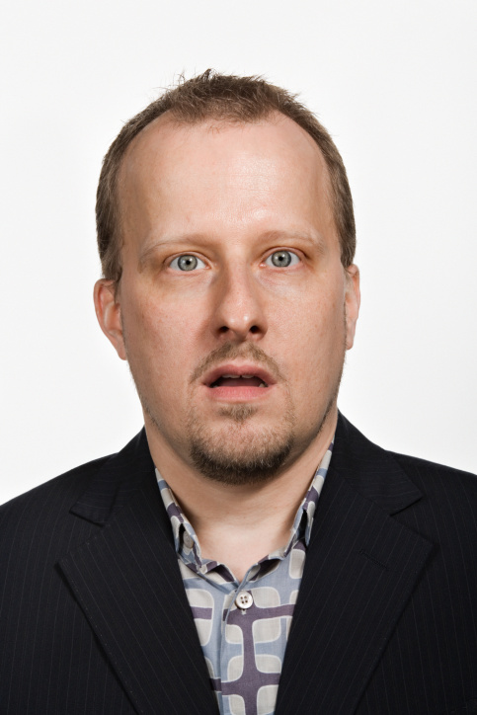
The Content Crowd
“Content is king”
Records managers
Broadcasters
Media types
Metadata
Control
“What if someone says something damaging?”

Slide 8





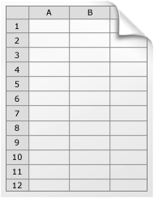





The Best of Both Worlds
User Experience – PC, Phone, Browser
The Future of Productivity
Social Networking and Collaboration
Traditional Content Management
Search Delivers Engaging Information Experiences

Slide 9
Act II: An Example Solution

Slide 10
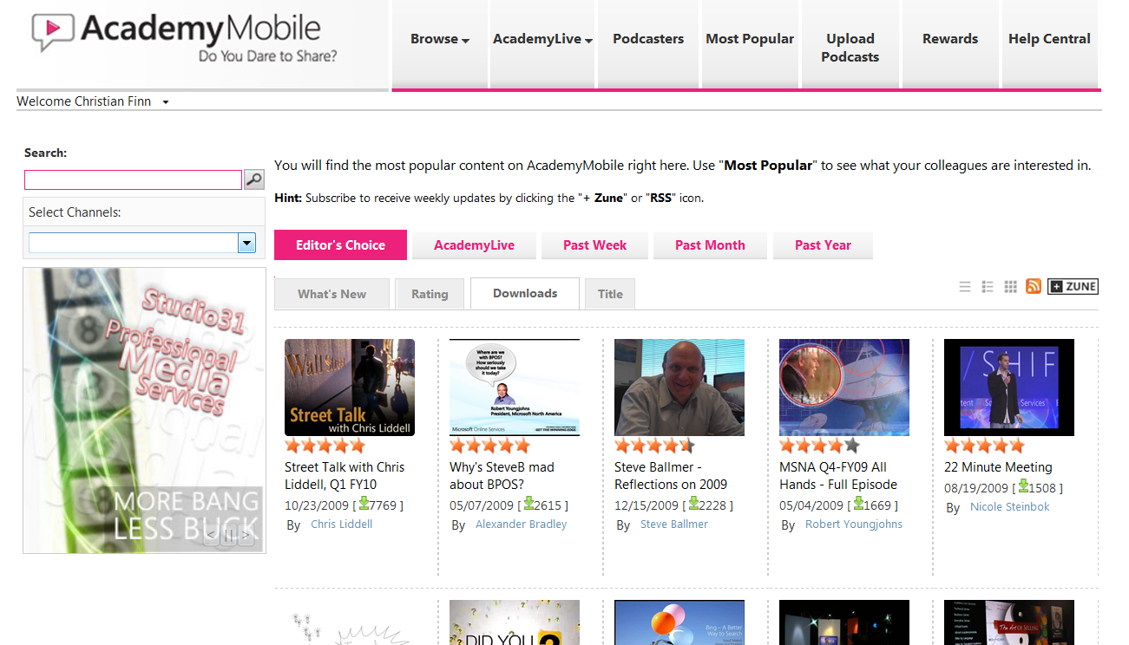
A Case in Point: AcademyMobile

Slide 11
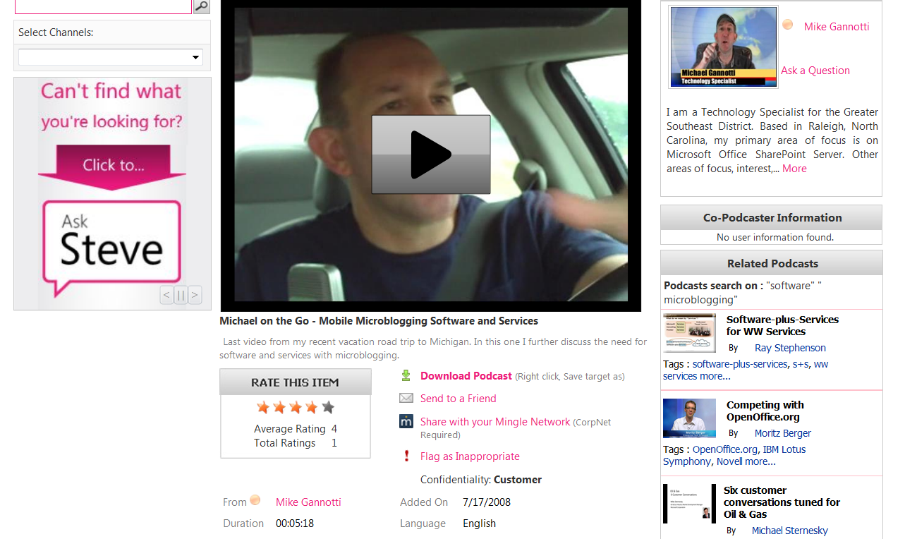
Podcast

Slide 12
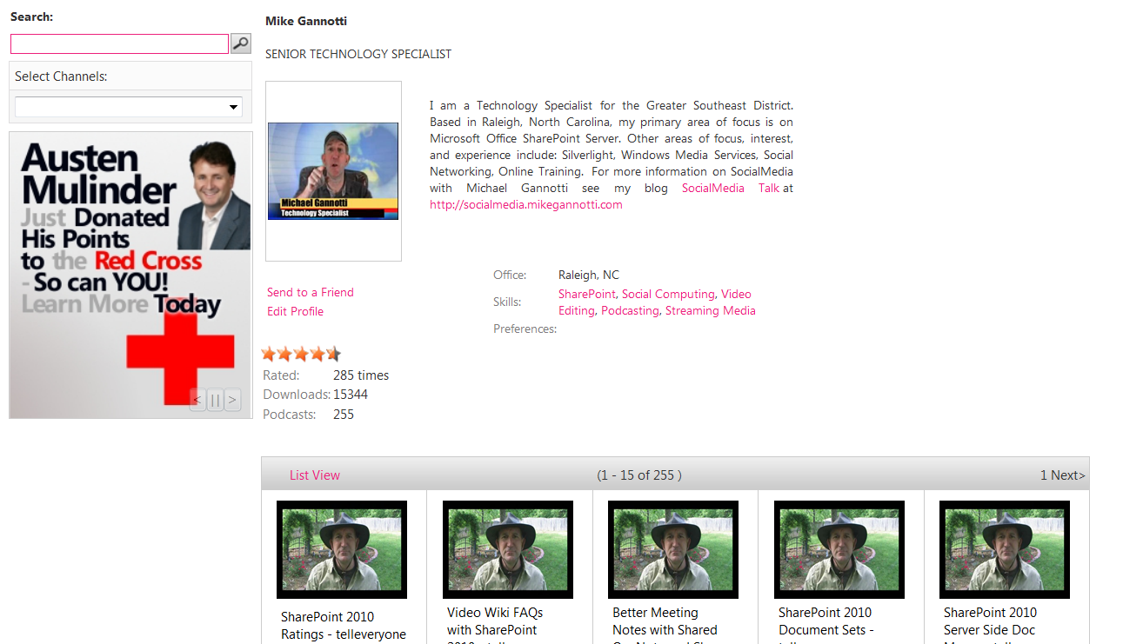
Podcaster

Slide 13
What’s the Value?
Let us count the ways
Cost avoidance for training
  No T&E/event costs, no design costs
  One event, 100 people, $1K T&E = $1M+
Global knowledge sharing & retention
  Connecting people who haven’t met
  Immersive sharing, easy retention
Employee engagement
  Reputation and recognition
  Building bonds

Slide 14
Act III: Mythbusting

Slide 15
Popular Myths
Build it and they will come
People will flame each other/the organization
Marketing “X for the Enterprise” works
It’s only for people under 30
We can’t make a $ and ¢ business case

Slide 16
Keys To Success
You have to start with pain users feel
People won’t flame if they are not anonymous
Facebook & YouTube have some negative baggage, esp. in the C-Suite
Anyone can create and derive value, but they must be pitched appropriately

Slide 17
Making A Hard $ Business Case

Slide 18
Act IV: Have Your Cake…

Slide 19
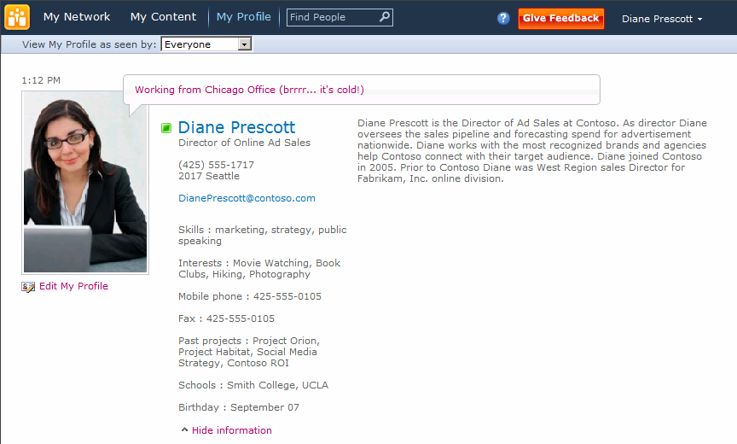
My Profile
Profile picture and status updates
Contact details and bio
Skills, interests, and previous projects
Personal information

Slide 20
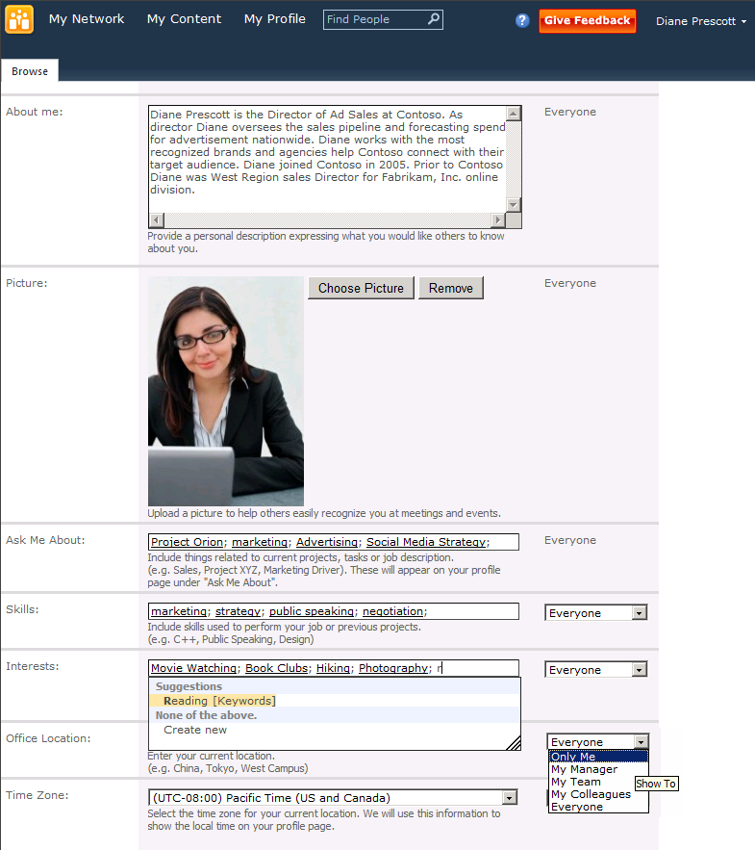
Profile Management
Choose from suggested keywords
Specify privacy options

Slide 21
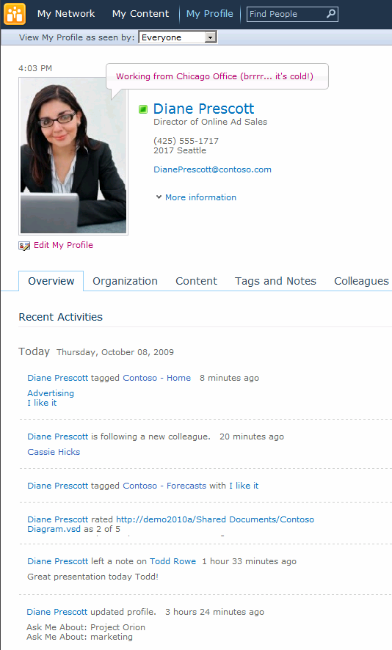
Recent Activities Feed
Tagging
Colleague Network updates
Rating
Comments and Notes
Profile updates

Slide 22
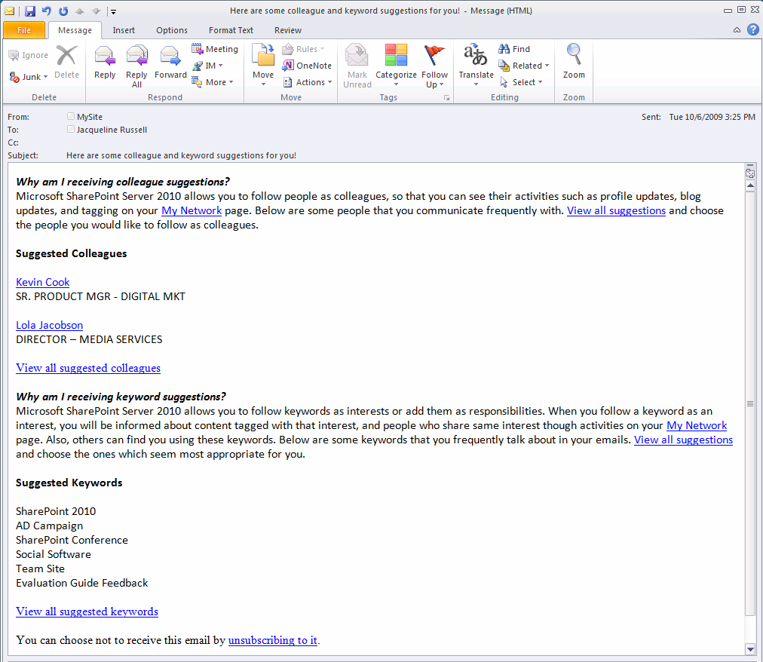
Suggestions
Colleague and keyword mining from Sent e-mails
Privacy policy at enterprise and end-user level
Notes:
Expertise Analysis:
Keywords from Sent E-mails, noun phrase extraction in 6 languages
Social Tags for the person
Tags used by a person
Expertise Opt-in:
Track as Interests
Ask Me About
Privacy policy at Enterprise and End-user level
Expertise Search
High relevance score for “Ask me about”
Social Distance as a part of relevance algorithm
Filter results by Title and Location
Keyword related documents

Slide 23
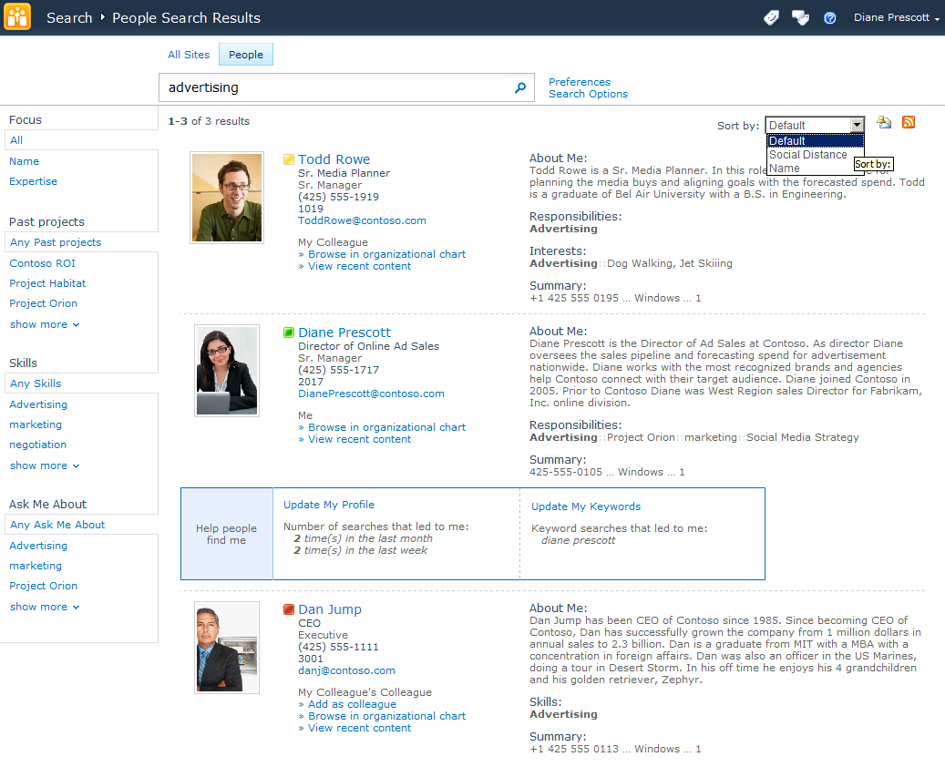
People Search
Sort by social distance
Tips for helping others find you
Filter by social metadata

Slide 24
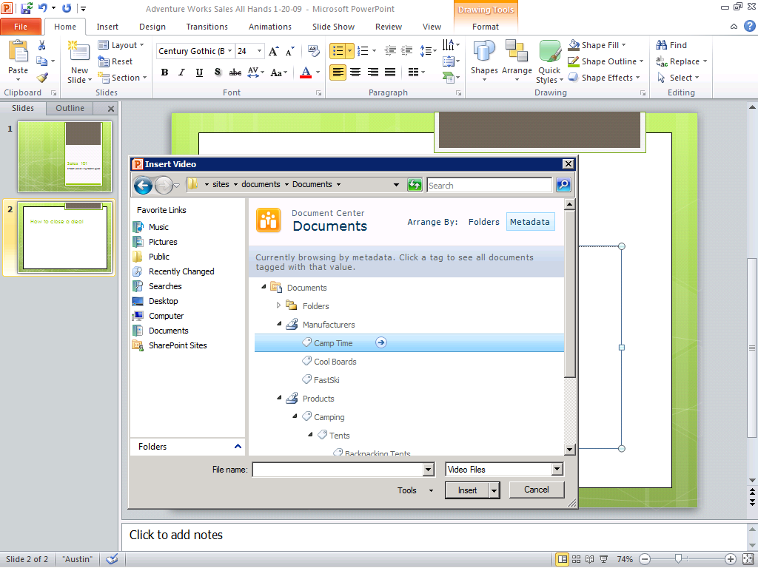
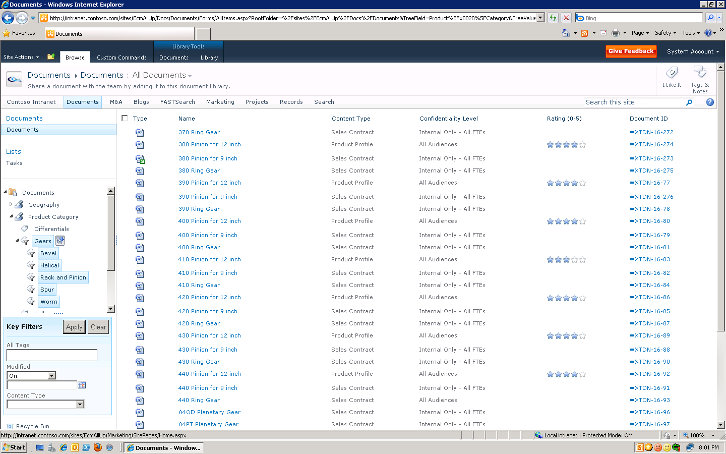
Metadata
Metadata-based Navigation

Slide 25
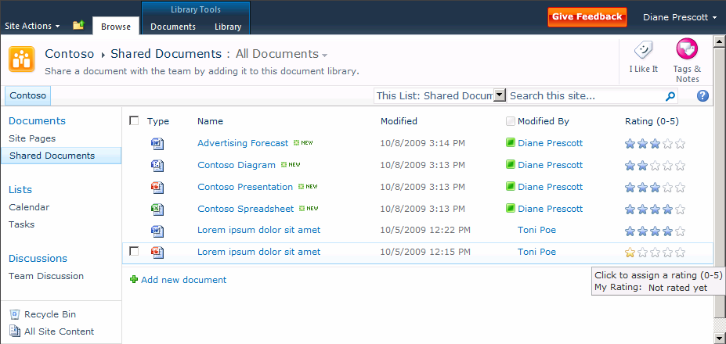
Ratings
Rate pages and content
0–5 star ratings

Slide 26
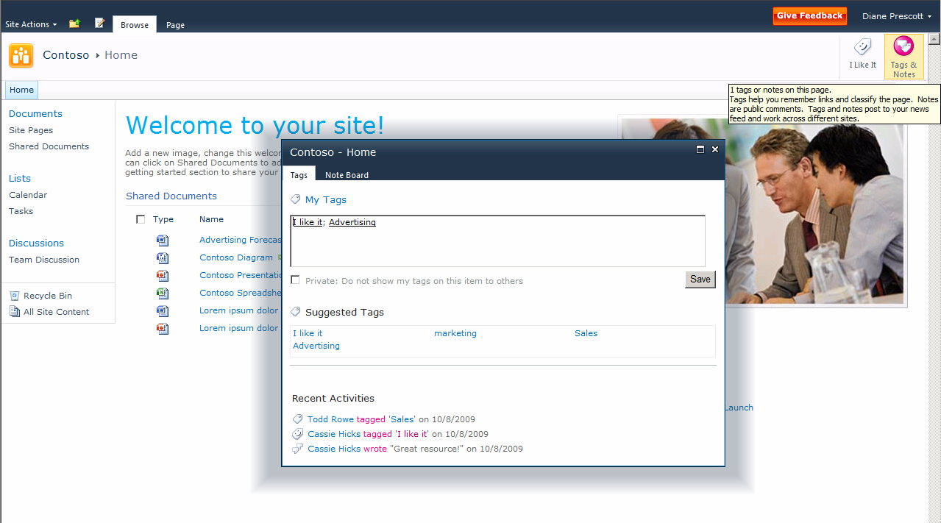
Tagging
Tag sites, lists, libraries, or items
Suggested tags
Recent tag and note board activity
Notes:
Managed Metadata Service
Tag entry UX: Type-ahead, Auto-suggest, Disambiguation
Bind to SharePoint List column
Filtering: Exclusive (prop = value), Inclusive (prop ‘under’ value)
Integration with Site Navigation:
1 or many Term Sets for multi-lingual, synonyms
Term management to merge, copy and reuse terms
Termset importer

Slide 27
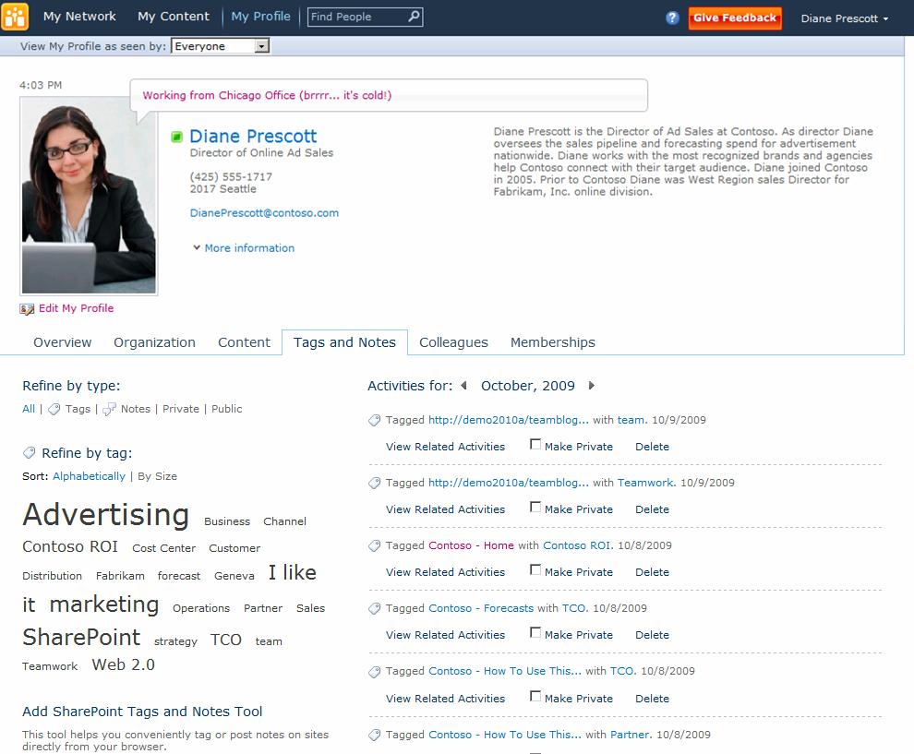
Manage Tags and Notes
See all tagging activity
Filter by tags, notes, or public/private
Sort tag cloud alphabetically or by size
Filter by keyword

Slide 28
Find the Information You Need
Metadata Navigation within Microsoft Office
Notes:
Office Integration
Text
Locate Media by Term Store
Insert Screenshot of Selecting Media Process

Slide 29
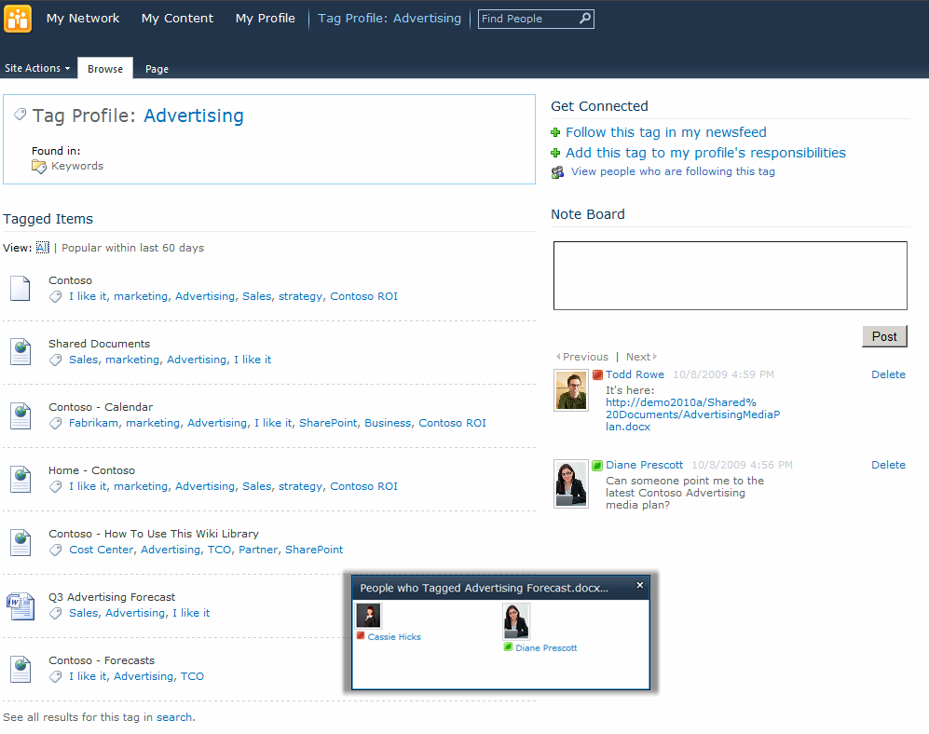
Tag Profile Pages
Tag profile pages as communities of interest
Follow as interest, or add as responsibility
Read, or leave comments on Note Board
Tag pages, lists, libraries, or items
See people using this tag

Slide 30
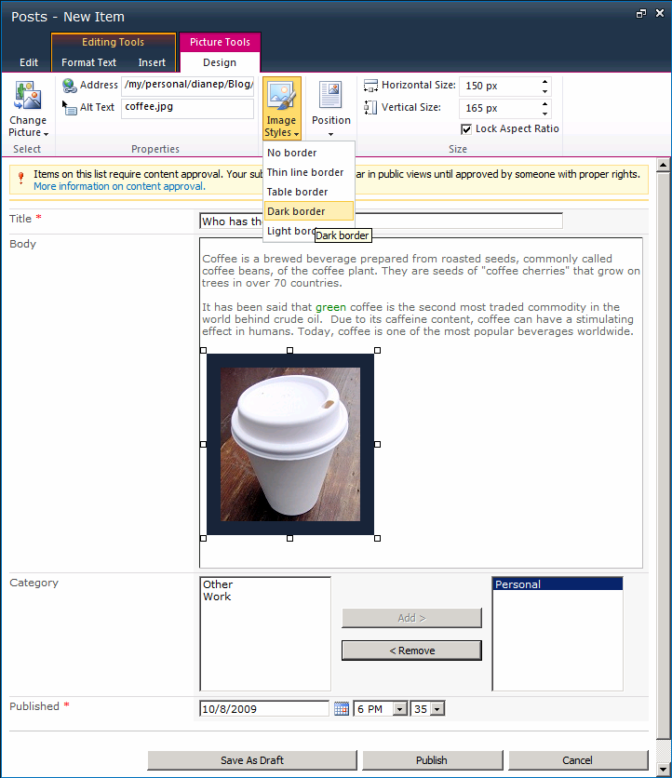
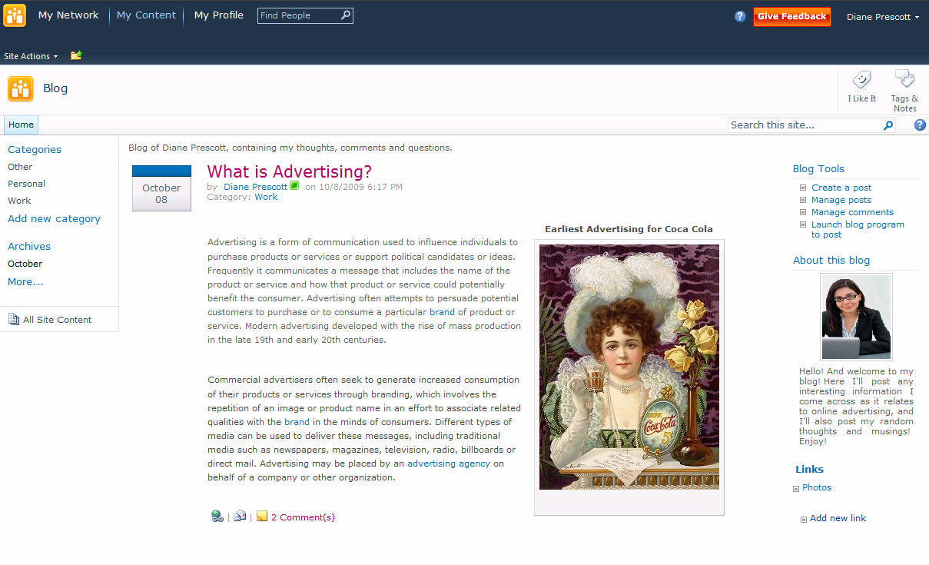
Blogs
Rich text editor with contextual ribbon menus
Wrap text around floating images
Modern user experience with AJAX
Customizable categories
Built-in image styles
Easy content management
Rich content creation

Slide 31
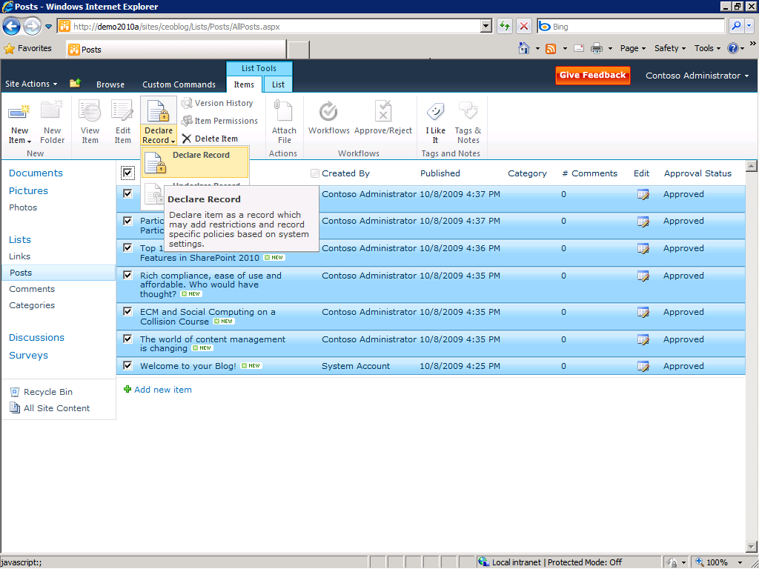
Bloggers, Meet the Records Mgr
Declare blog posts (and wiki pages and podcasts) as records

Slide 32
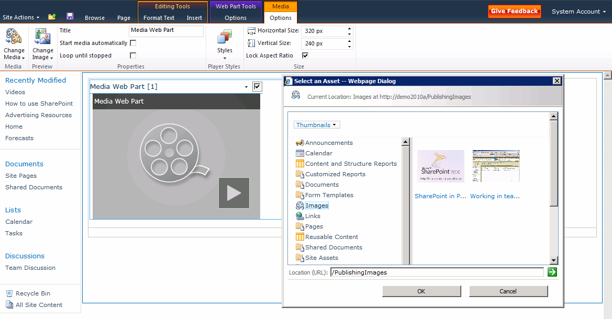
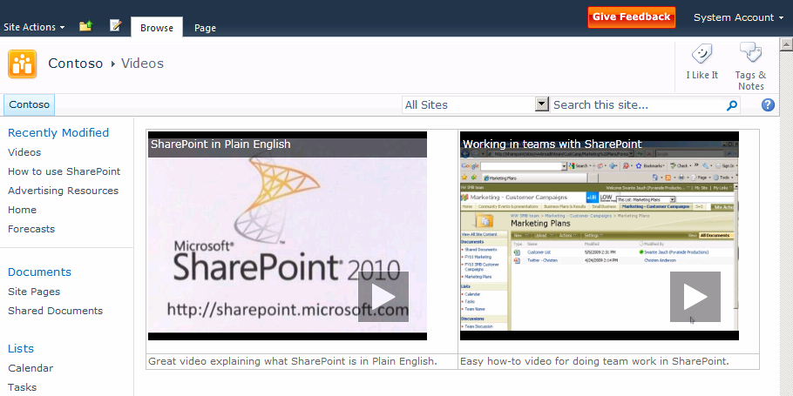
Video
Play internal or external hosted video
Store rich media assets in SharePoint
Streamed from on-disk cache
Skinable Silverlight Player
Notes:
Video in SharePoint
Parity with Documents
Streamed from on-disk cache
IIS bitrate throttling module regulates streaming
Burst upfront, then delivers at encoded bitrate
Supports seeking
Stored in SQL or external BLOB store
Silverlight player
Field control and Webpart
Skin-able
Plays both internal and external video

Slide 33
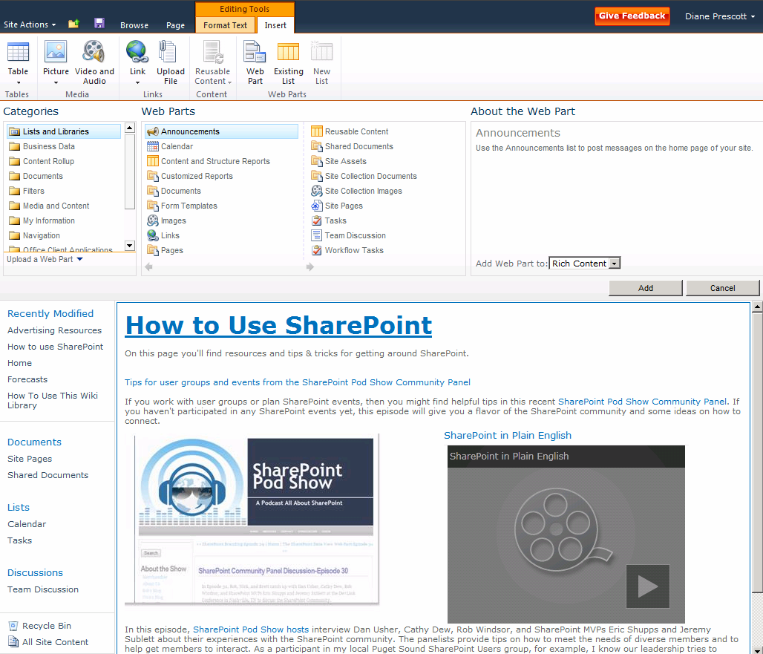
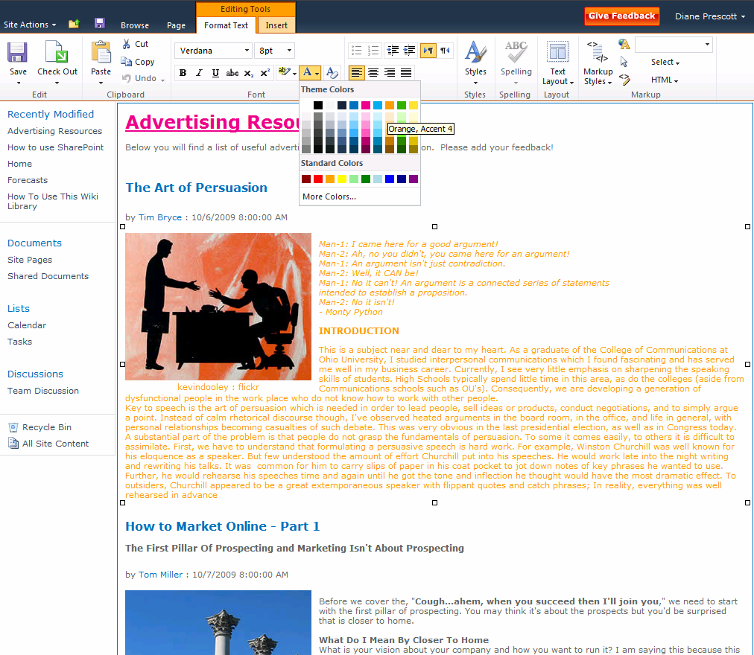
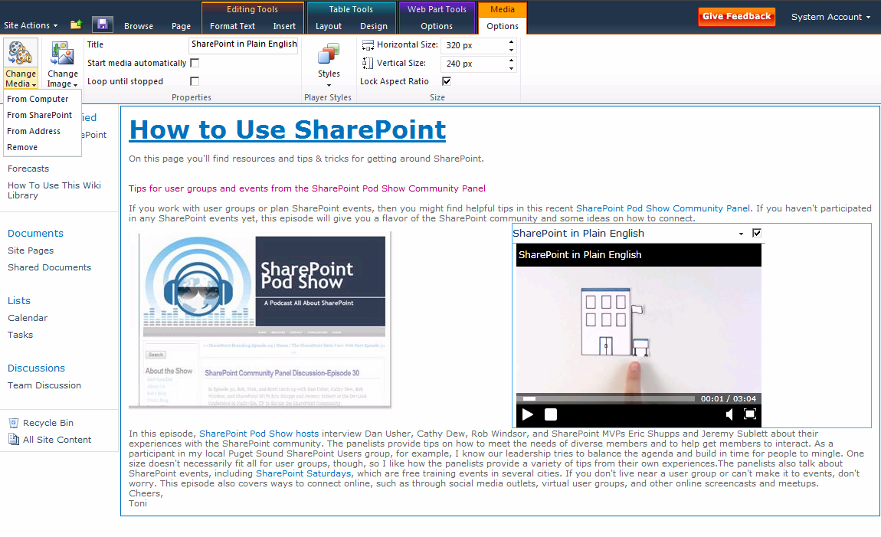
Wikis
Add web parts to wiki content
Rich formatting with preview capabilities
New web part gallery
Embed rich media

Slide 34
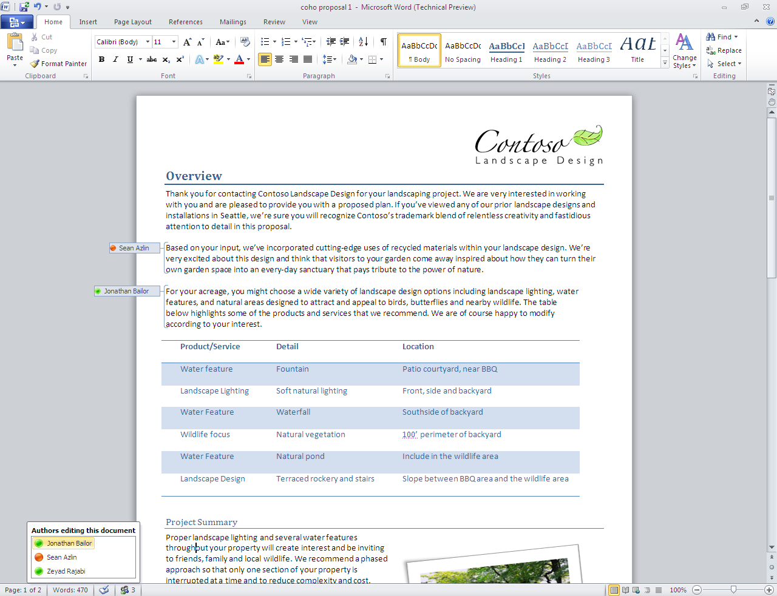
Co-Authoring Experience in Office
Participants

Slide 35
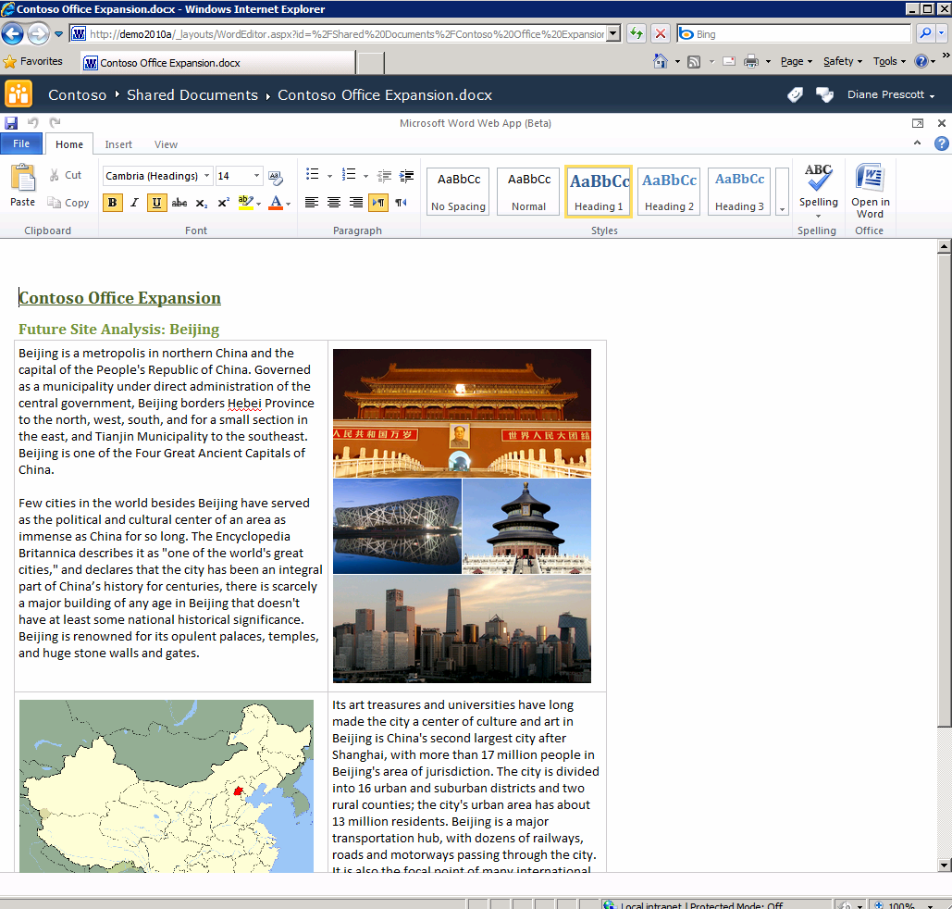
In-Browser Editing
Rich editing with Ribbon menus
Office Web applications for in-browser content editing and collaboration

Slide 36
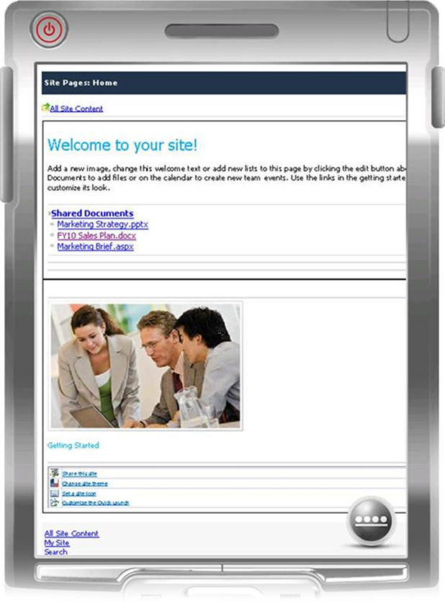
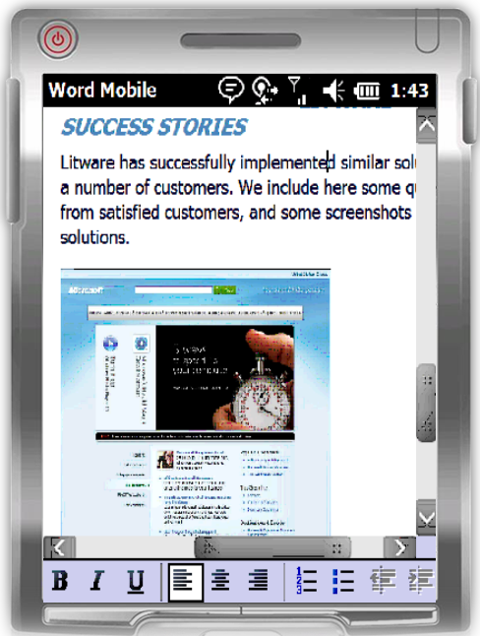
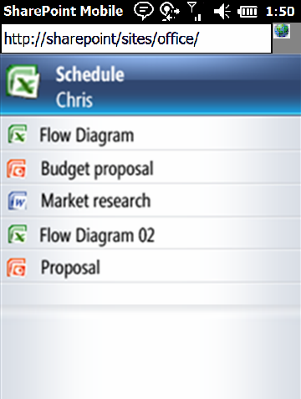
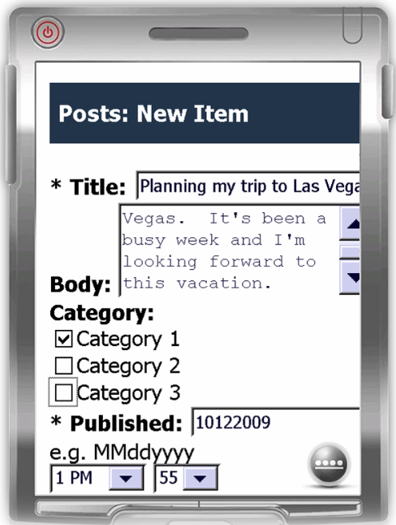
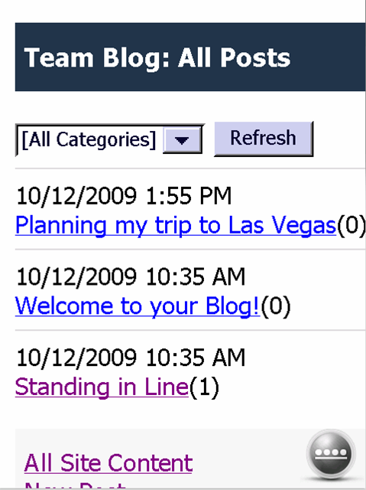
Mobile Collaboration
Access to Team sites
Access to Office applications
SharePoint Workspace Mobile
1-click access to documents, sites, and colleagues
Create Blog posts and comments

Slide 37
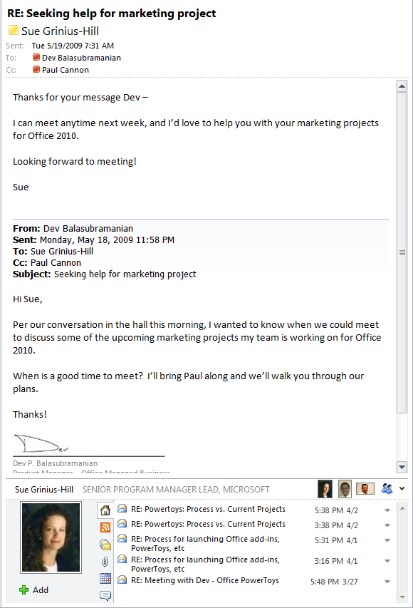
Outlook Social Connector
Inline social context with e-mail thread
Interaction history

Slide 38
Act V: All About You

Slide 39
Find out more at: www.microsoft.com/sharepoint
Thank You!

Slide 40

© 2010 Microsoft Corporation. All rights reserved. Microsoft, Windows, Windows Vista and other product names are or may be registered trademarks and/or trademarks in the U.S. and/or other countries.
The information herein is for informational purposes only and represents the current view of Microsoft Corporation as of the date of this presentation. Because Microsoft must respond to changing market conditions, it should not be interpreted to be a commitment on the part of Microsoft, and Microsoft cannot guarantee the accuracy of any information provided after the date of this presentation.
MICROSOFT MAKES NO WARRANTIES, EXPRESS, IMPLIED OR STATUTORY, AS TO THE INFORMATION IN THIS PRESENTATION.

